Slide 1
Analysis of Factors Affecting House Prices: Case of Dublin, Ireland
Akhileshkumar M. Subbarao and
Kadesh B. Huddar
Under guidance of Dr. Alan F. Smeaton
August 2020

Slide 2
Outline
1.Introduction
2. Data Used
3. Implementation and Analysis
4.Amenity Quantification
5. Conclusions

Slide 3
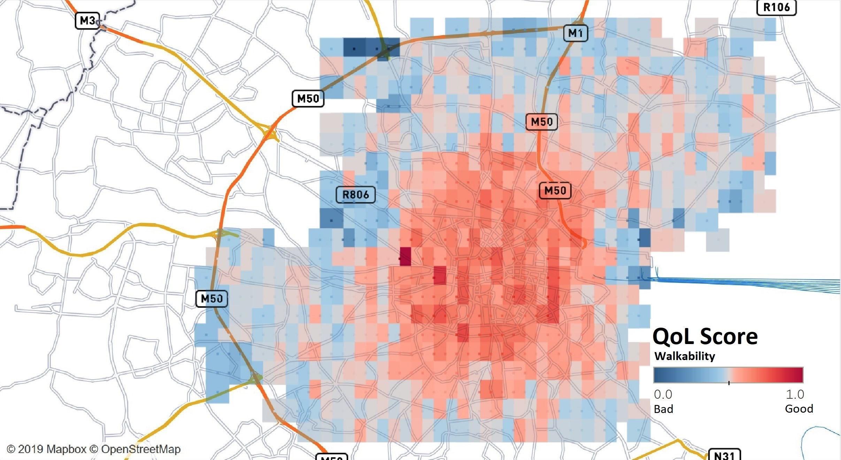
1. Introduction
A Quality of Life Scoring Matrix was produced by the Minkun Kim(MCM student) in 2019. It compared the Quality of Life at 1000 random points in Dublin.
QoL indicator –> accessibility to 1900 amenities, but did not provide deep insights on affects of walkability on house price..

Slide 4
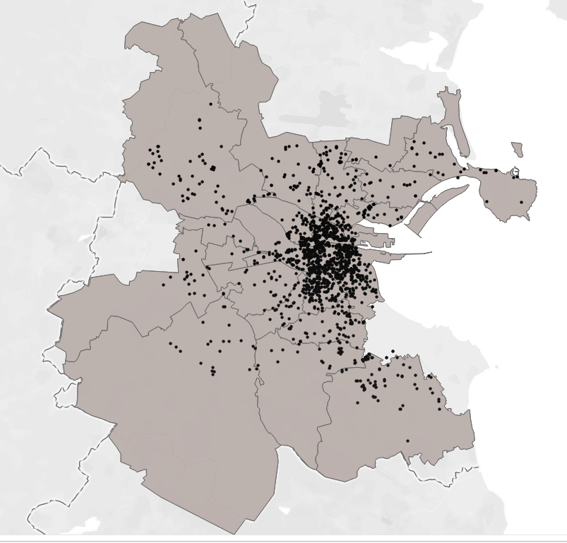
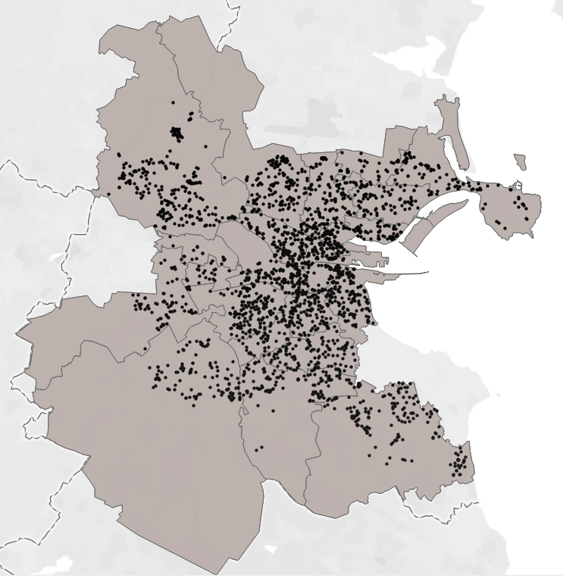
Aim: To analyse the impact of external factors on house price
Rent properties(D01-D24) Sale properties(D01-D24)
: Input
4204 properties(rent+sale) from daft.ie (not random points) + 6782 amenities (not 1900) and 18 categories + Importance Weights + crime data + distance to city centre

Slide 5
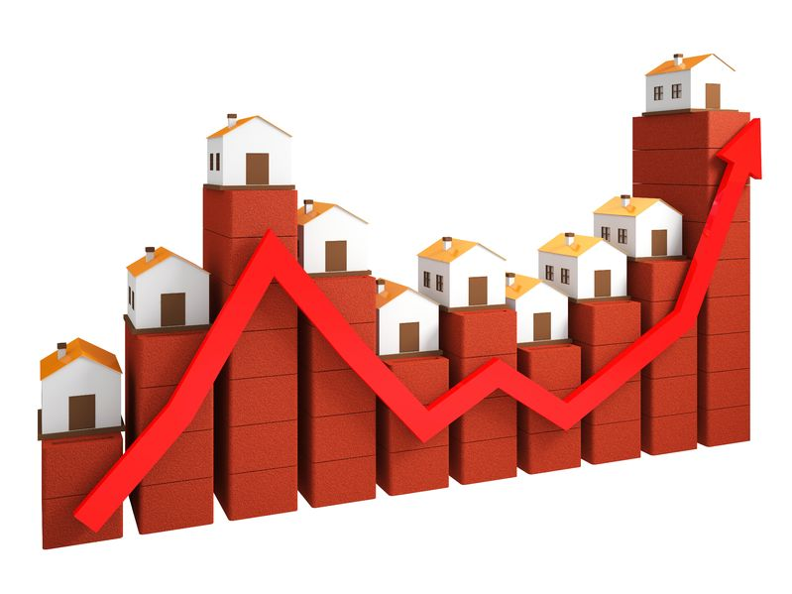
Concept to compute property score
Walkability
- Destinations (6782 amenities)
- Origins (4204 properties in D01-D24) - Euclidean Distance
- Footpath Distance
- Calculated all within 1 Km radius
Q. Walkability ?
Crime
Crime reported from 2007-2018
Categories
Severe
Moderate
Minor
Distance to City Centre: Distance from Spire to each property
Q. Crime rate?
Quality of Life?
Q. Distance
To CC

Slide 6
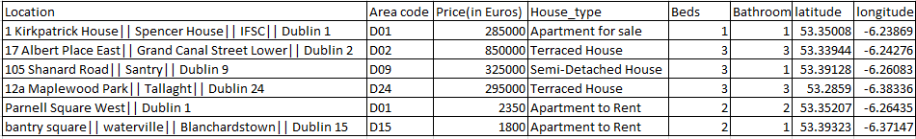
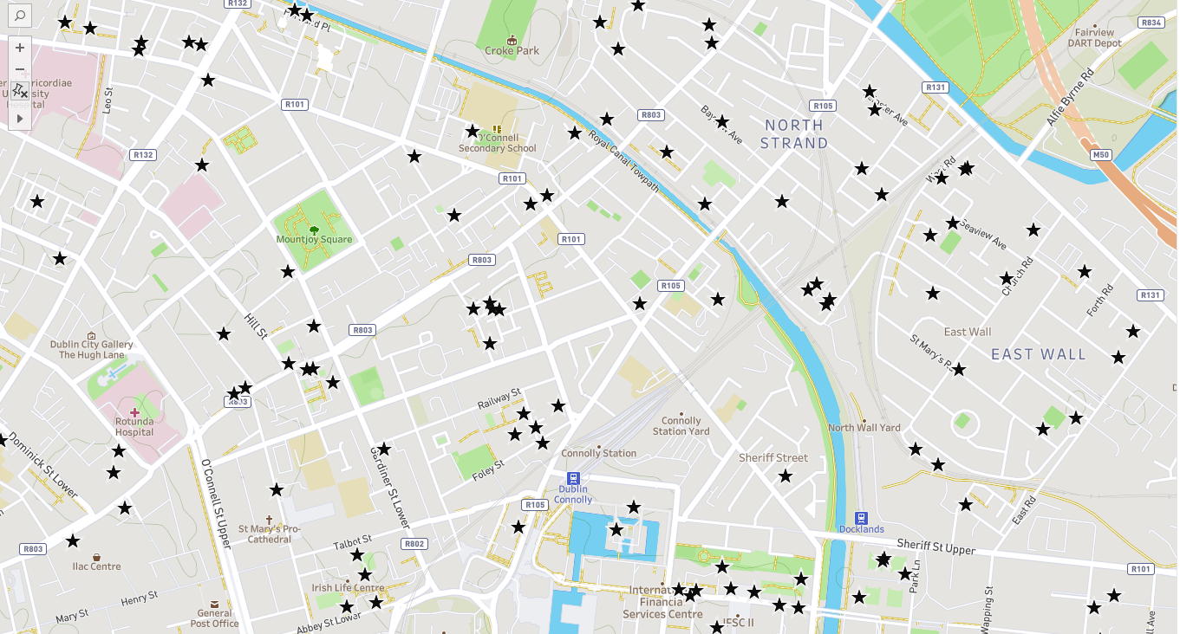
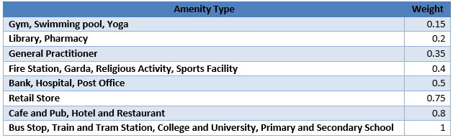
2. Data Used
: Amenity and Property Data
Sample properties on a Map
Categories(Extracted from management-ware Google Maps Contact Extractor V2.0).
Banks : 160
Bus Stops : 2,383
Cafes and Pubs : 616
Colleges and Universities : 158
Fire Stations : 14
Garda Stations : 31
General Practitioners : 167
Gym, Swimming pool, Yoga : 380
Hospitals : 255
Hotels and Restaurants : 632
Libraries : 87
Pharmacies : 331
Post Offices : 135
Primary and Secondary Schools : 481
Religious Activities : 85
Retail Stores : 464
Sports Facilities : 311
Train and Tram Stations : 92

Slide 7
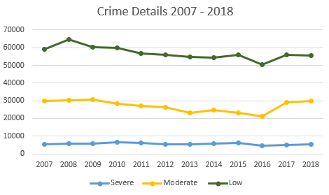
: Crime Data
Crime reported from 2007 to 2018 is collected from Central Statistics Office(CSO)
12 categories of crime subdivided into 3 main categories
Severe
Attempts or threats to murder, assaults, harassment and related offences
Kidnapping and related offences
Robbery, extortion and hijacking offences
Moderate
Burglary and related offences
Fraud, deception and related offences
Dangerous or negligent acts
Damage to property and to the environment
Weapons and Explosives Offences
Minor
Theft and related offences
Controlled drug offences
Public order and other social code offences
Offences against government, justice procedures and organisation of crime

Slide 8
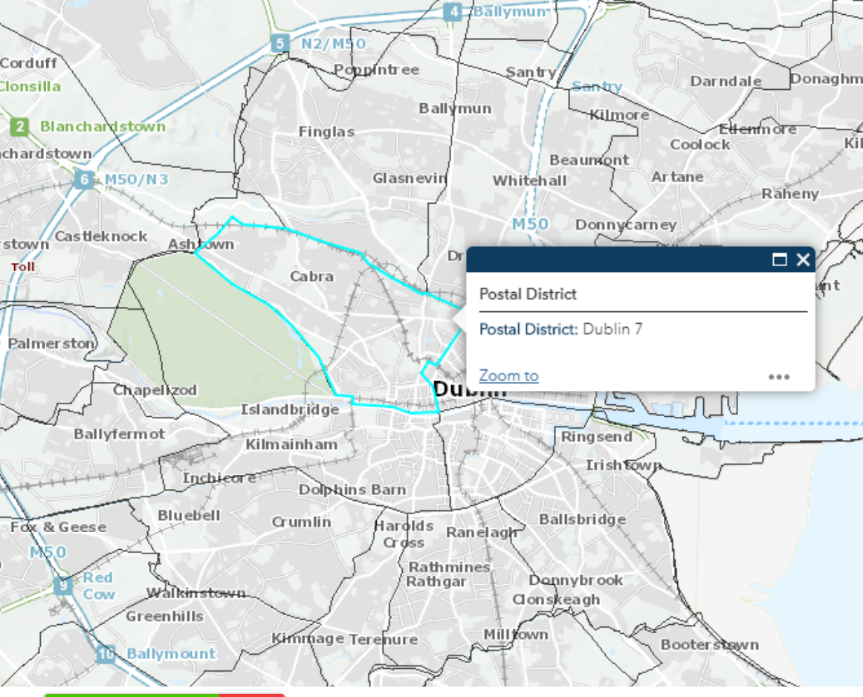
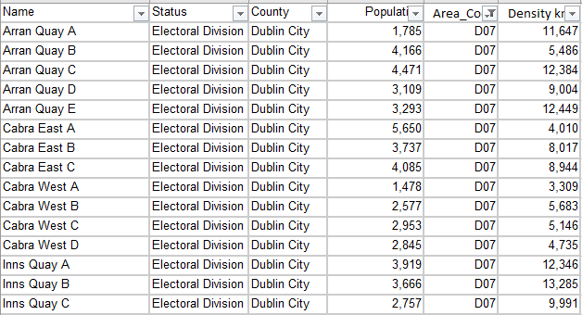
: Population and Density Data
Electoral division data gathered from www.citypopulation.de/en/ireland/dublin/ website (based on 2016 census data)
259 electoral division in Dublin
: Distance to City Centre Data
Distance to each property from Spire (city centre)
Less score for isolated areas/far from city centre.

Slide 9
: Property Data
4204 properties are scraped from daft.ie website
Data includes both rent and sale properties
: Amenity Data
6782 amenities extracted from management-ware Google Maps Contact Extractor V2.0 software
Data is collected for each postal code and sub areas and combined, cleaned to form final data set
: Crime Data
Excel from Central Statistics Office (CSO)
Data was available for each year, from 2007 -2018 with 12 categories
Data in each garda subdistricts are combined to form total crime reported from 2007-2018
: Population and Density Data
citypopulation website which contains population and density of each electoral division
259 electoral divisions in Dublin.
Each electoral division are manually mapped to postal districts using postal boundaries given by Dublin Housing observatory.
: Distance to City Centre Data
Distance is calculated for all 4204 properties using Google distance matrix API.

Slide 10
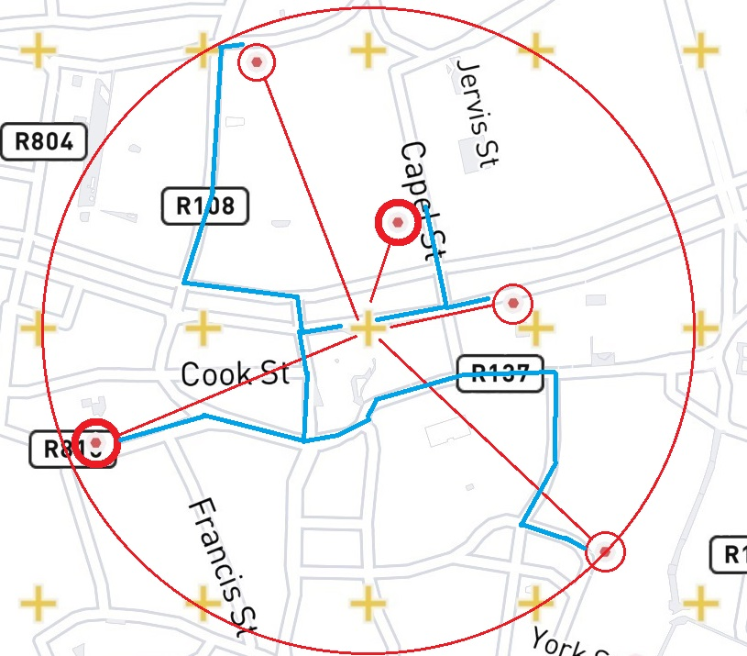
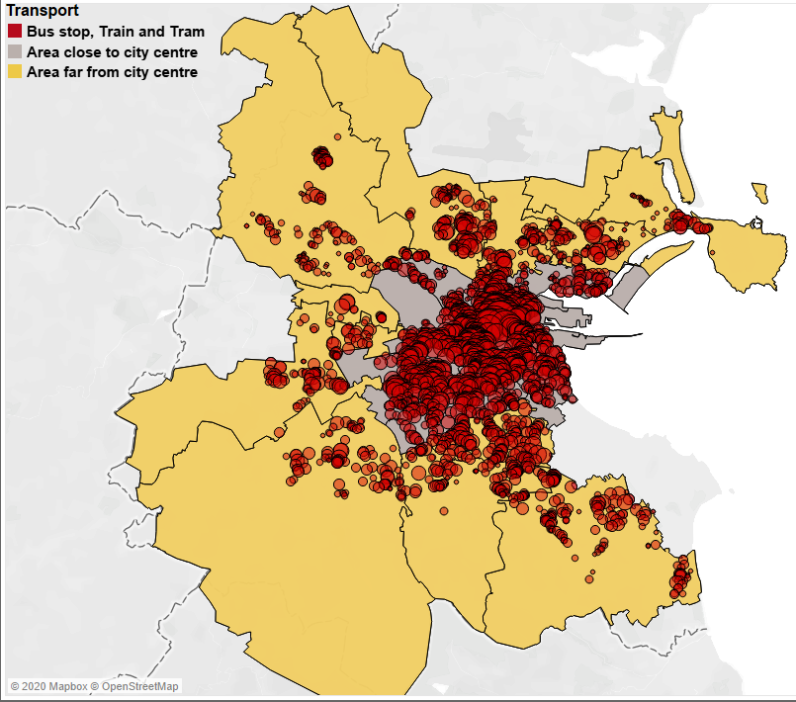
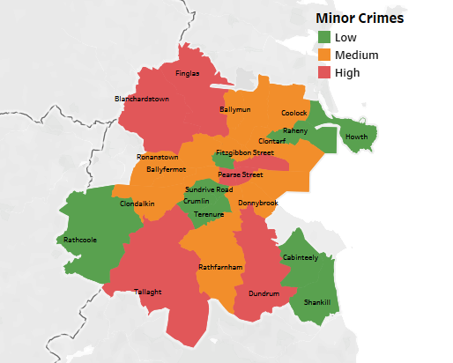

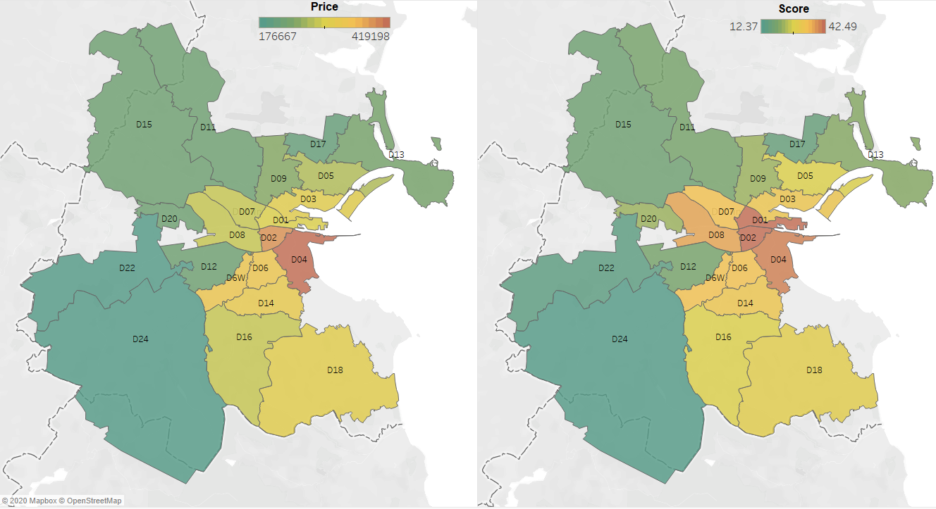
3.Implementation and Analysis
Step 1
Step 2
Step 3
Step 4
Step 5
Step 6
Computing straight lines with Euclidean distance
Computing footpath distance with Google Map API
Computing
Amenity score
and visualising Amenity spread
Computing
Crime score
and visualising crime categories
Computing
Distance to City Centre score
Computing
Overall property score and analysis

Slide 11
1 Km
: Computing straight line with Euclidean distance
Euclidean distance: Origin as Property and Destination as Amenities using Haversine formula
Distance within 1km radius.
2km
0.5km
: Computing walkable distance using Google Map API
Distance Matrix : Footpath distance between two address
Distance within 1km footpath distance.
Mode : “walking”. Transit route preference : ‘’ less walking “
API call for each property and amenities are not reliable
Over 900000 API requests.
API request output in Json;
‘Distance’ leg provides footpath distance

Slide 12
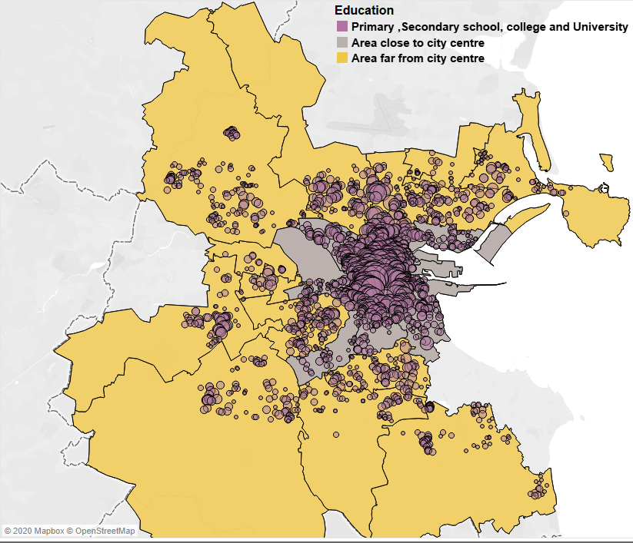
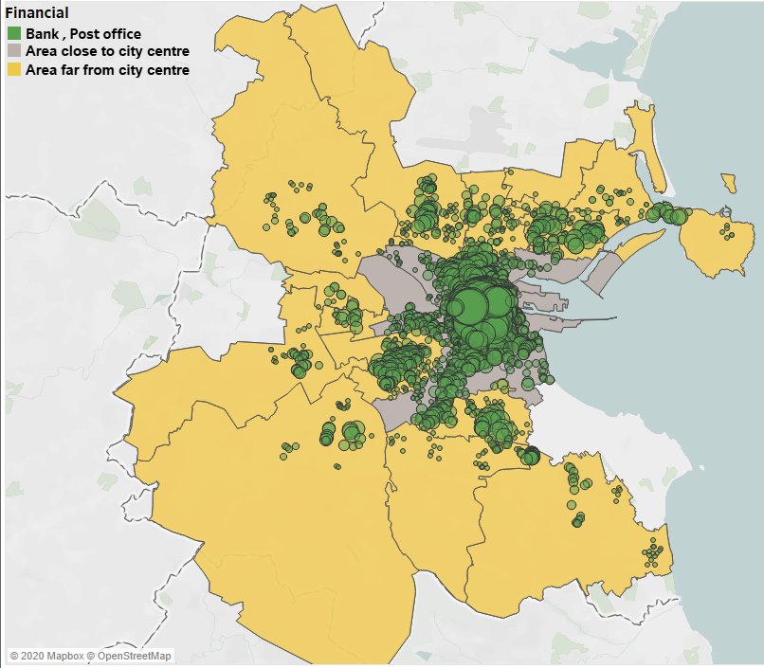
: Computing property score
Property score = sum of all the weights of surrounding amenity within 1km footpath distance.
Visualizing amenity components for 4204 properties: 18 categories subdivided into 8 categories
Weighted amenity plot :
Better infrastructure at city centre.
Big circle represents rich amenities.
Dublin postal code boundaries
Property points and circle

Slide 13
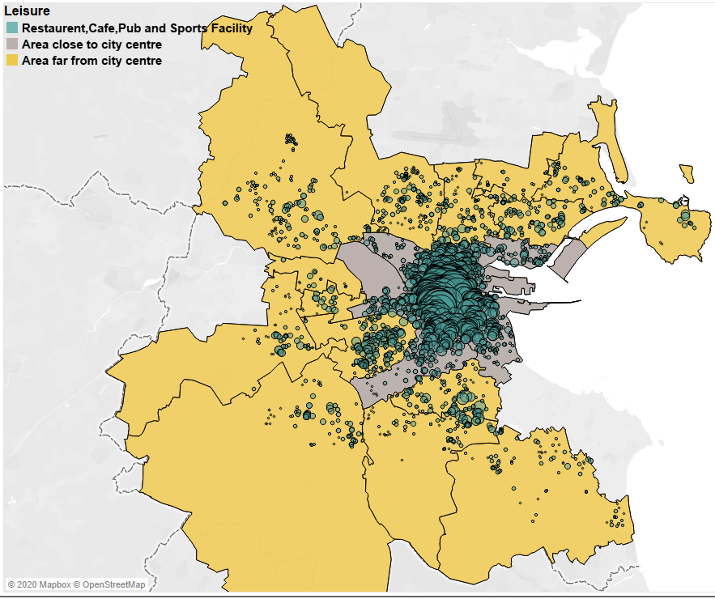
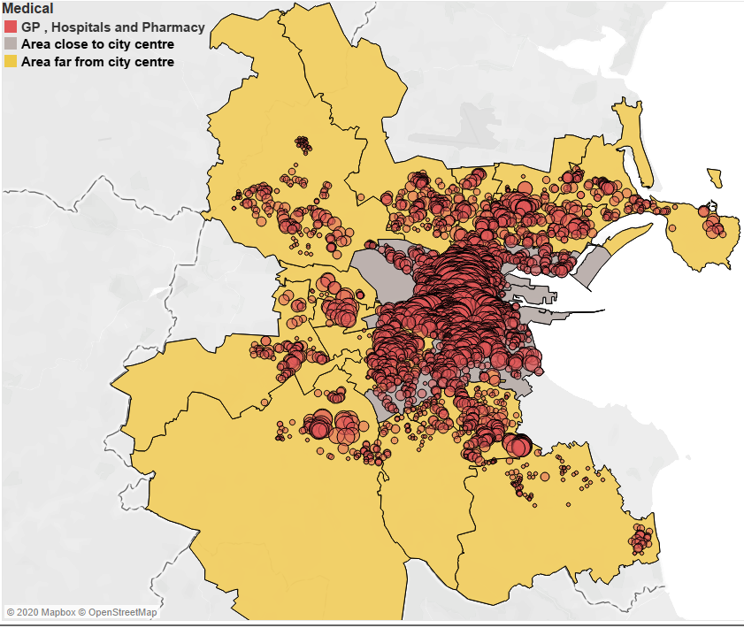
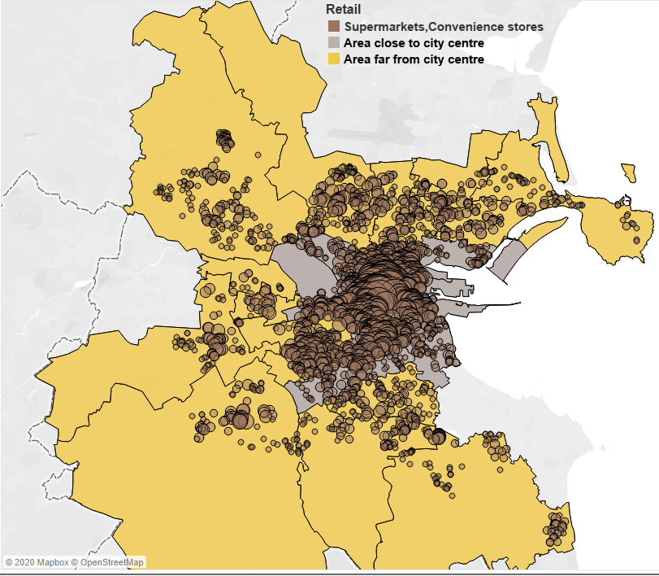
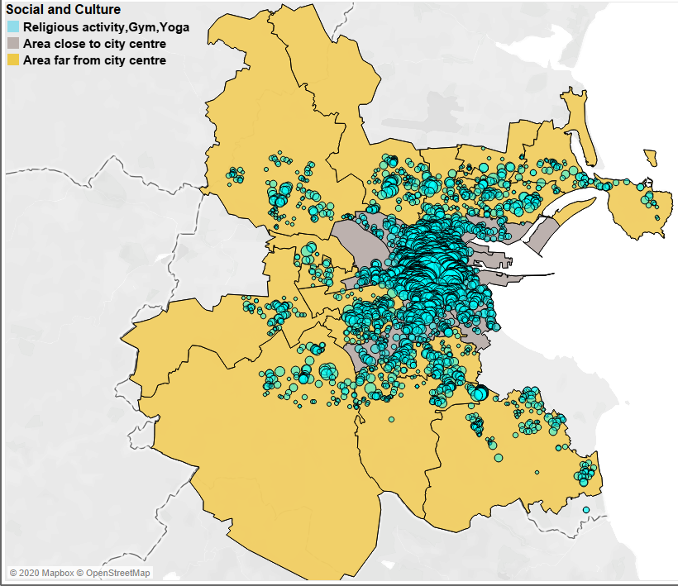
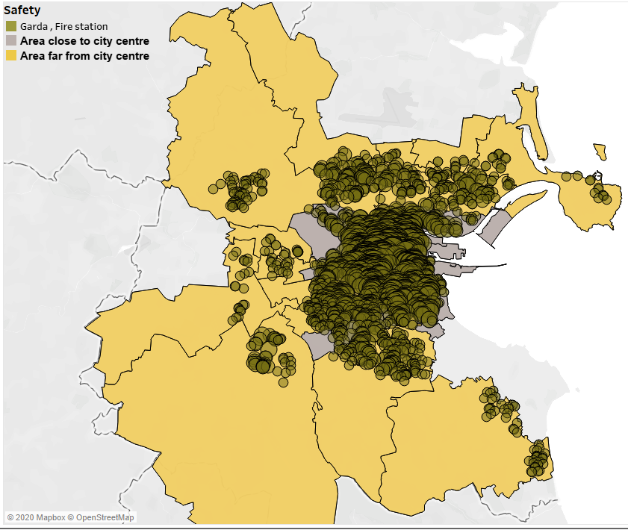

Slide 14
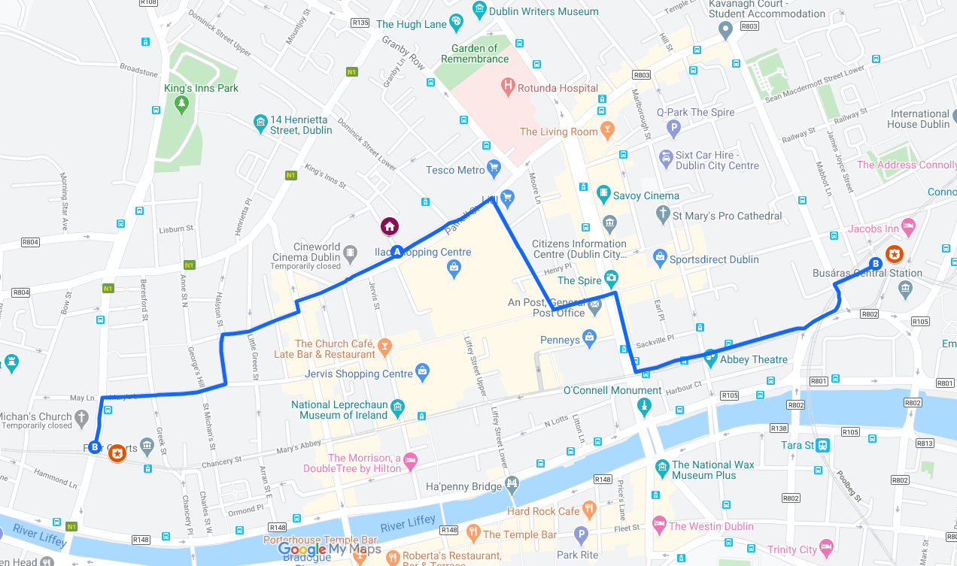
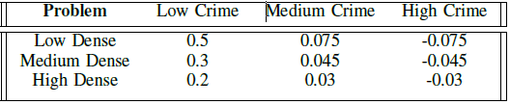
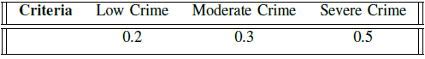
: Computing crime score
4204 properties are mapped to nearest garda station
Special case : properties near to postal code boundaries
Garda station in same area, but it is not at shortest distance.
Choose this as garda Jurisdiction.
16 Kings Inn Street(D01)
Inter Quartile Range
Store Street(D01)
Population density
Crime categories
<25%
Low Dense , Low crime
0.9 Km
1.2 Km
>=25% and <75%
Medium Dense , Medium crime
Bridewell(D07)
>=75%
High Dense , High crime
9*3 decision matrix
High crime rate and less people, rare chance but dangerous to live. So more negative points
Low density , low crime rate best place to live!
Obvious chance of more crime in high dense region. So less negative scores!!

Slide 15
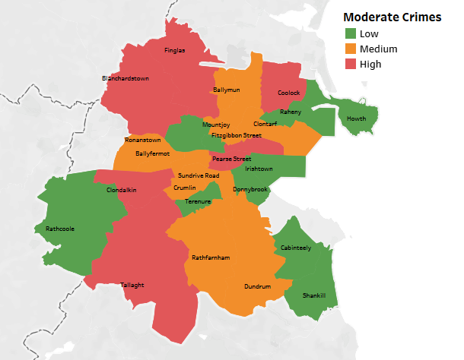
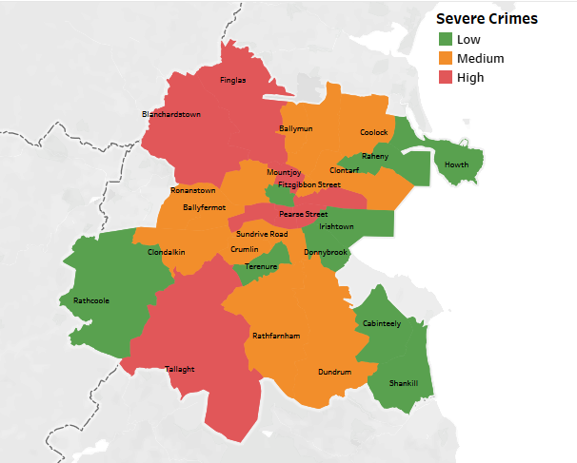
Visualizing the crime data for all crimes reported in 31 garda stations
Garda boundaries from CSO 2011 Garda subdistrict data
Merging each crime category with boundary data.
: Computing Distance to cc score
Distance from Spire to 4204 properties
Near to city centre properties have added advantage
0.34 * property distance from city centre is reduced from
total score

Slide 16
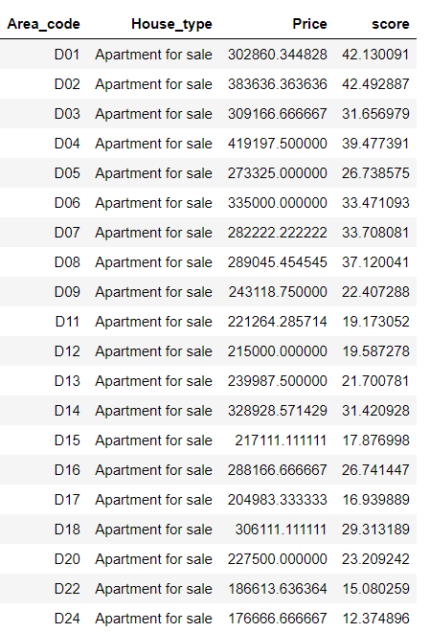
: Sale analysis :
Overall sale scores = score of amenity walkability + score of crime rate + score of distance to city centre. It is computed for 2370 sale properties from daft.ie
Purchasing house is one of the biggest decision in life!!
Great location remains great asset in future
There will be a careful consideration of surrounding factors

Slide 17
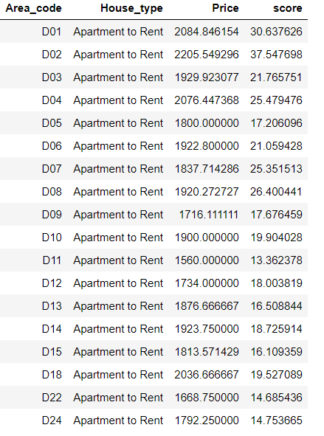
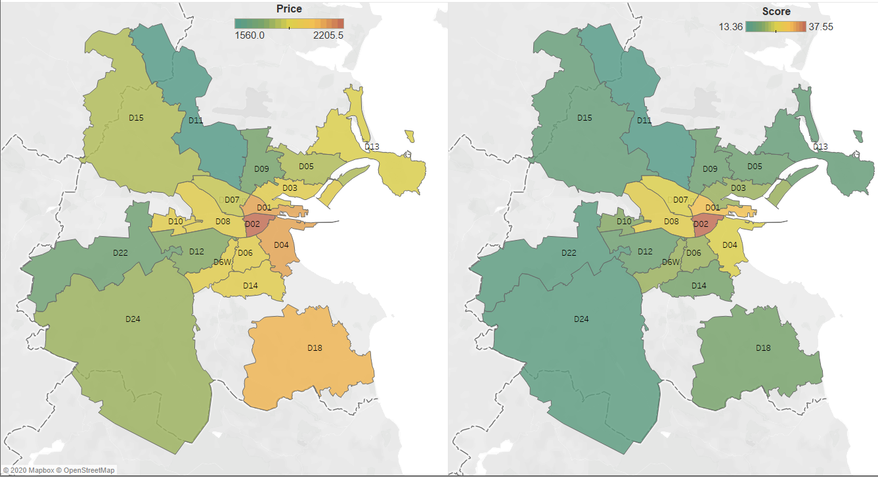
: Rent analysis :
Overall rent scores = score of amenity walkability + score of crime rate + score of distance to city centre. It is computed for 1834 rent properties from daft.ie
Random variation on comparing score to rent price.
Rent does not vary much along with changes in scores
Landlords tends to overprice the properties!

Slide 18
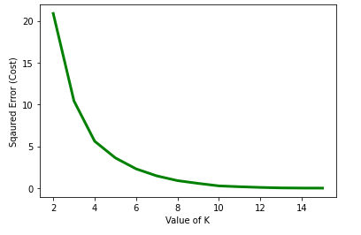
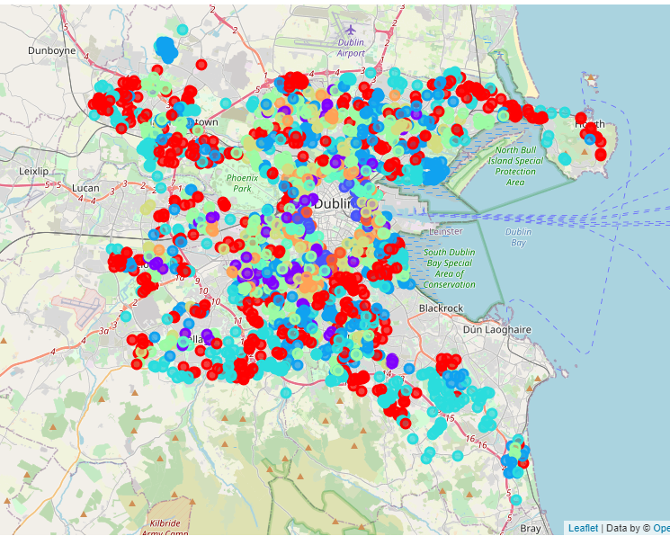
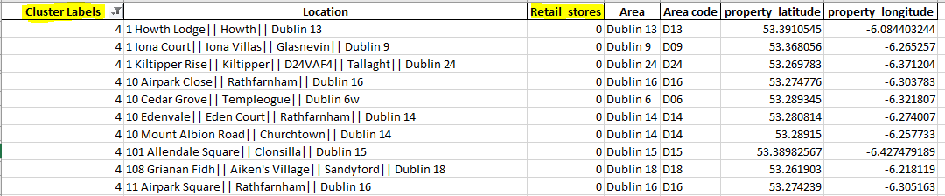
4. Amenity Quantification
Elbow method
Opening a retail store in an optimal location can help business grow
Helps urbanization of city and affects wider range of population
: K-means clustering:
Unsupervised Machine learning technique
Clustering is carried out on 2370 sale properties
Divides data into K clusters
We are interested in placing amenity where there is no retail stores
K = 10 is the optimal cluster
Cluster 4 (represented in blue) has 363 properties with zero retail stores

Slide 19
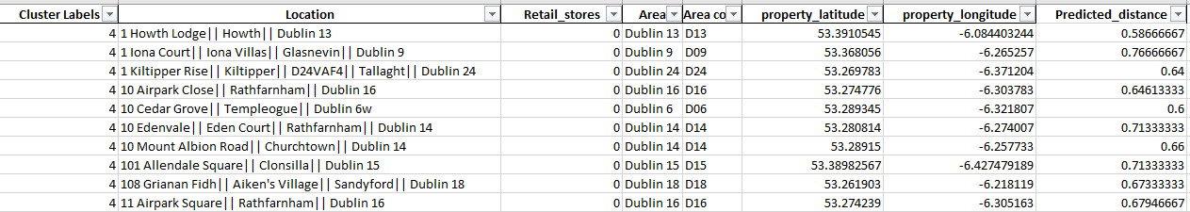
: K nearest neighbour regression:
Supervised Machine learning technique
To match with closest neighbors of training set and get avg value of nearest neighbors
Property co-ordinates and walkable distance of collected retail stores as training set.
KNeighborsRegressor metrics as “Haversine”;
Cluster 4 from k-means clustering is used as test set.
: Retail store placement using predicted distance::
Subset of properties rather than working with all properties
Dublin 15 with more than 100000 population.
Placing a store affects large population.
Clonsilla, Dublin 15 has 18 properties with zero retail stores.

Slide 20
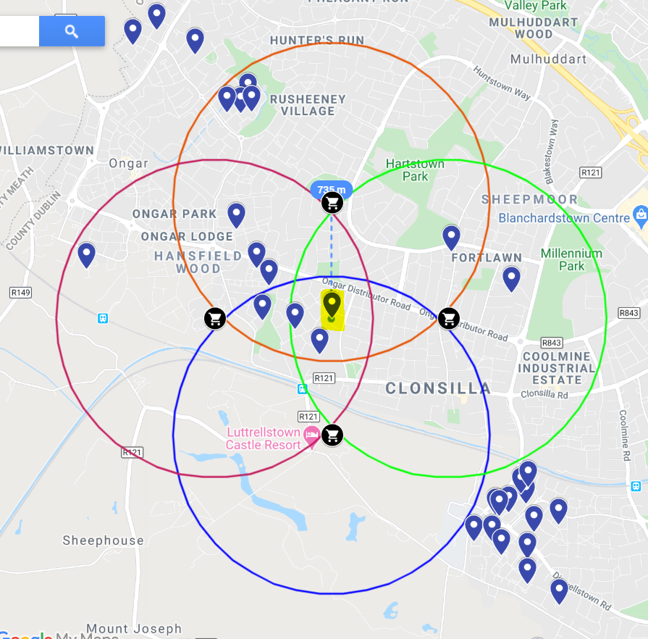
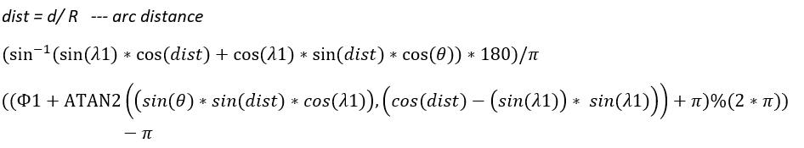


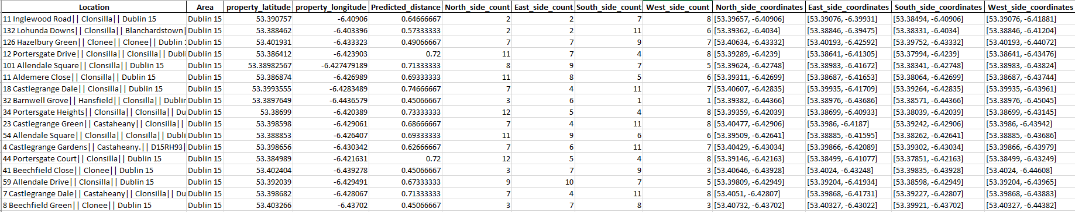
Reverse haversine
1 KM
Computes destination co-ordinates given source co-ordinates ,walkable distance and bearing angle.
θ = 0 is North , θ = π /2 is East , θ = π is South , θ = 3 *π /2 is West
0.735 KM
34 Portersgate Heights, Clonsilla, Dublin 15 and 44 Portersgate Court, Clonsilla, Dublin 15 which covers 12 properties out of 18
Placing a retail store to the North of this property near coordinates [53.39359,-6.42039] and [53.39146, -6.42163] would cover most of the properties, in turn helping a large population.
Predicted distance for 34 Portersgate Heights, Clonsilla, Dublin 15 is 0.735 Km
1 Km radius from predicted store.

Slide 21
5. Conclusion
Research puts a perspective on how external factors affects the property price
Sale properties have variation very sensitive to the surrounding factors
There are many external factors affecting the price. Future work can include more external factors
Model can be extended to create property recommendation system
Optimal placement model can be extended for various amenities like bus stop , garda , schools etc. as principle remains same
Future work can include details like site information , spending power of people in that area , income for that area
Study mainly focus on sustainability and walkability, which are the mainstream agenda items for government to move society towards a greener lifestyle. Model helps to inform the government of the areas that need better infrastructure for efficient urbanization and betterment of Dublin city.

Slide 22
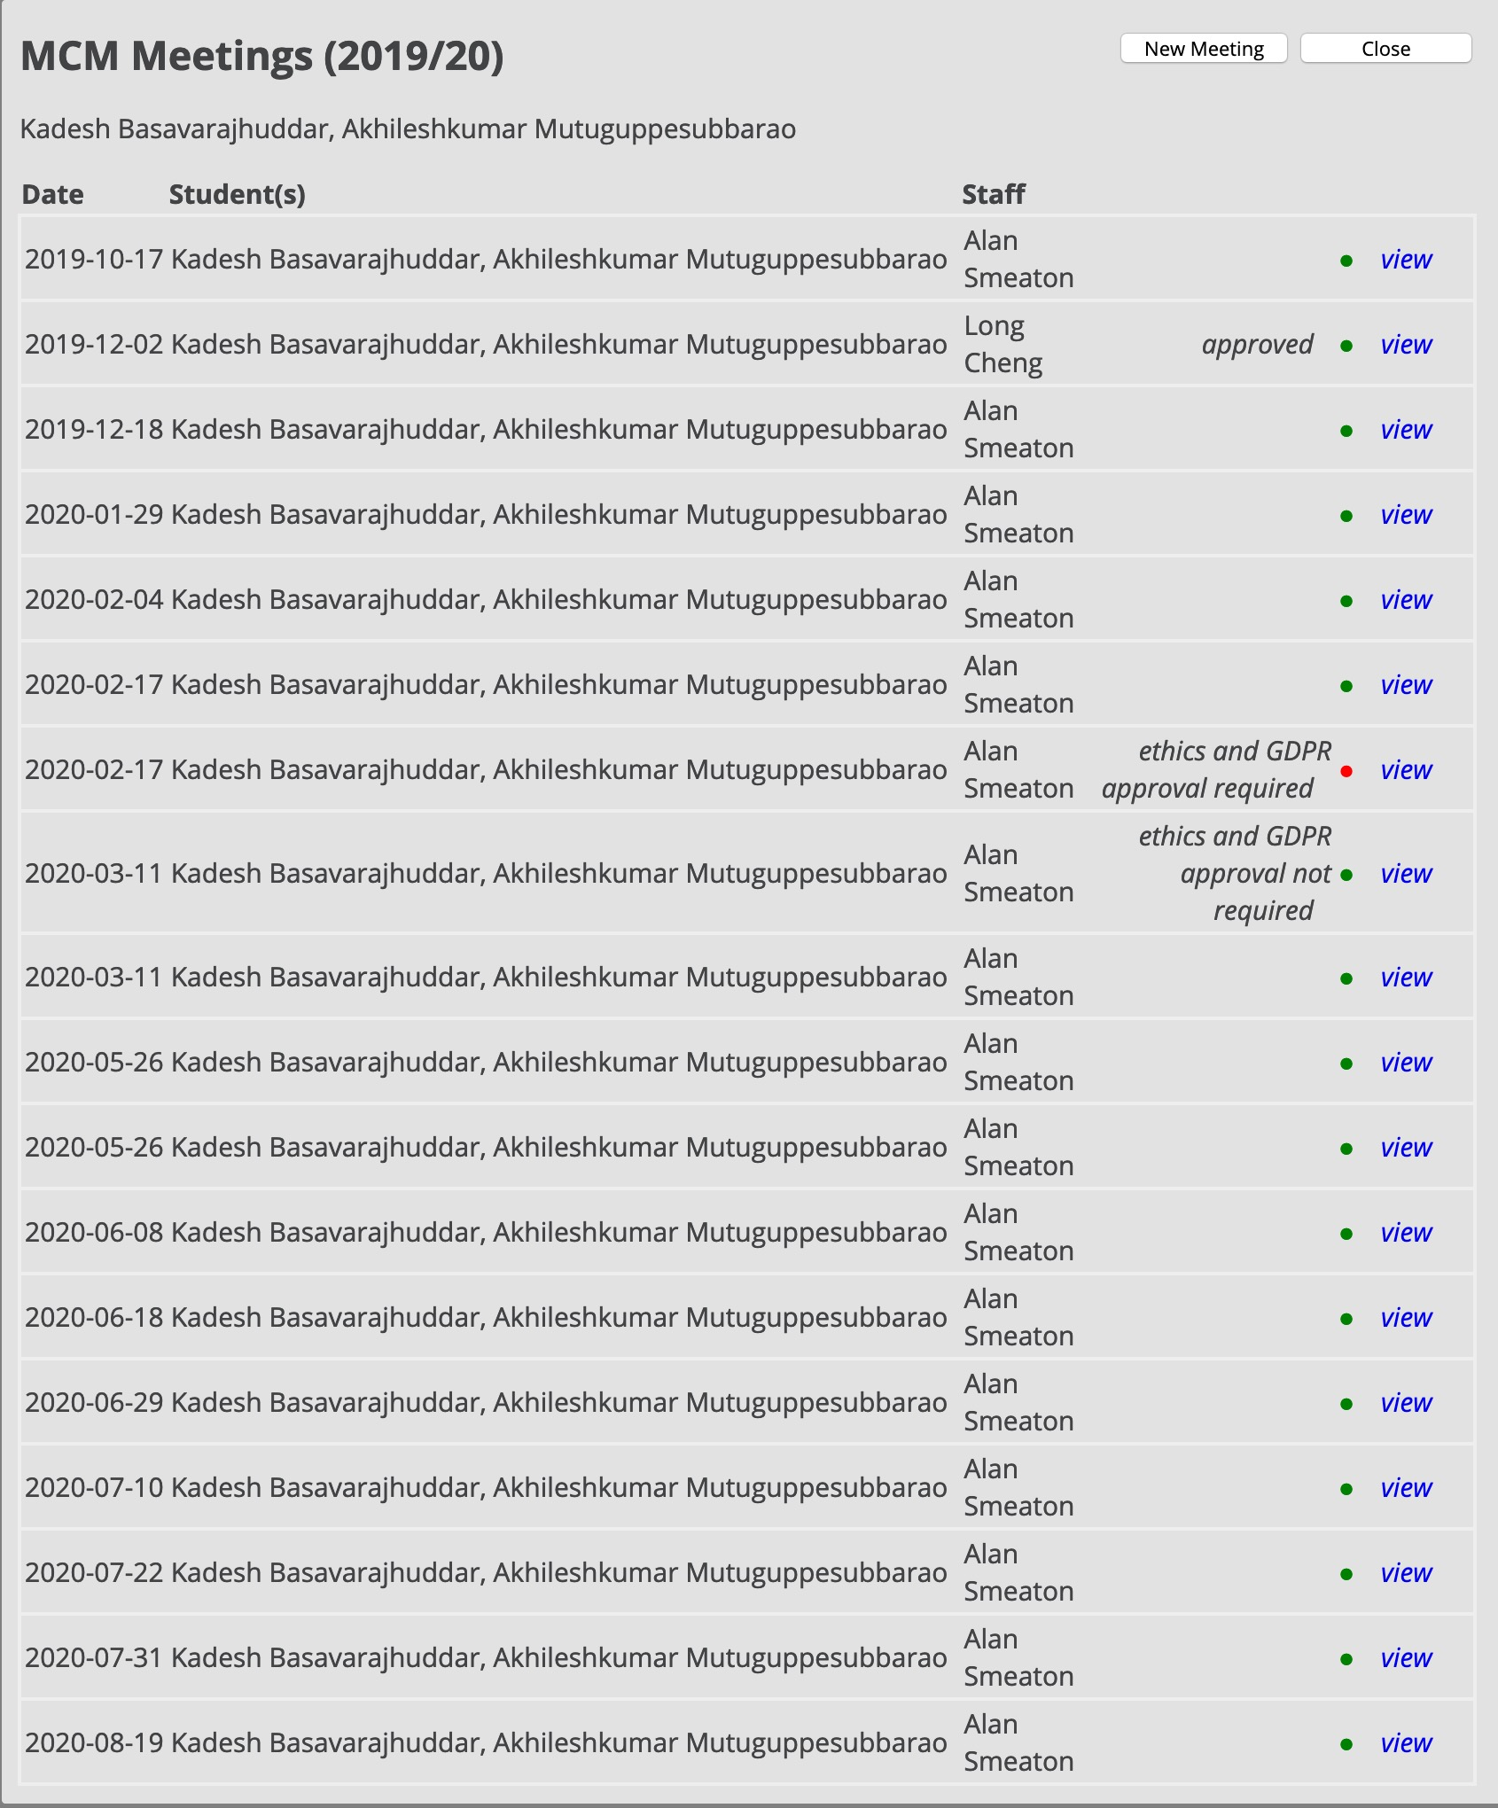
A good number of interactions with Dr. Alan F. Smeaton throughout the research led to better analysis and results!!
Thank You

